Slide 1
LD – DIET Back Office Application
Use only Windows Internet Explorer and Mozilla Firefox.
Please install Silverlight software on first time login.

Slide 2
INTRODUCTION
Log in Path :http://14.140.212.226:3030/lddiet.web
Log in Path :http://125.22.48.130:3030/lddiet.web
The application can be access from Internet Browser.
The new features are :
Ledger and transaction statement etc. of all clients in single excel sheet.
PIN Option
Search Option
Ledger, Statements can be exported in pdf. Format.
New Look and Feel !

Slide 3
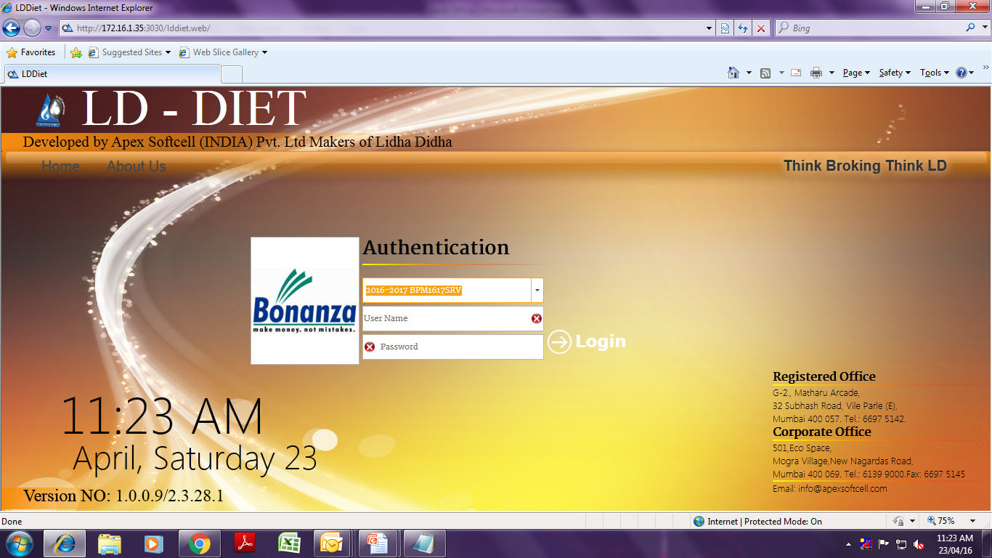
How to Log in.. Select FY and Type User ID and Password. (Your existing user id and password will remain same.)

Slide 4
Cont… Select Company (BPL for Equity and BCBPL for Commodities.)

Slide 5
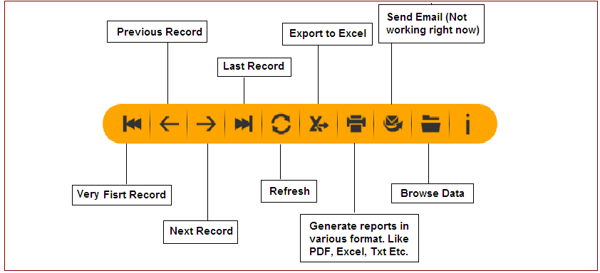
Introduction of Buttons

Slide 6
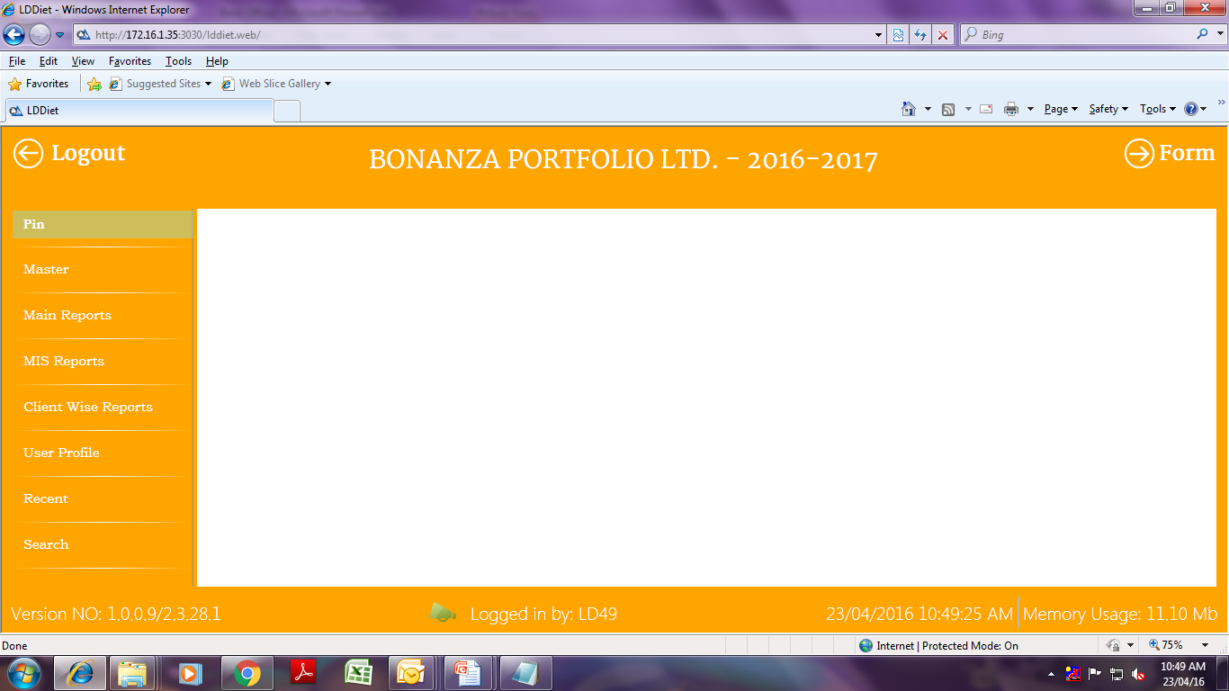
Main Page

Slide 7
Pin You can pin your most useable reports in PIN menu for quick navigation.

Slide 8
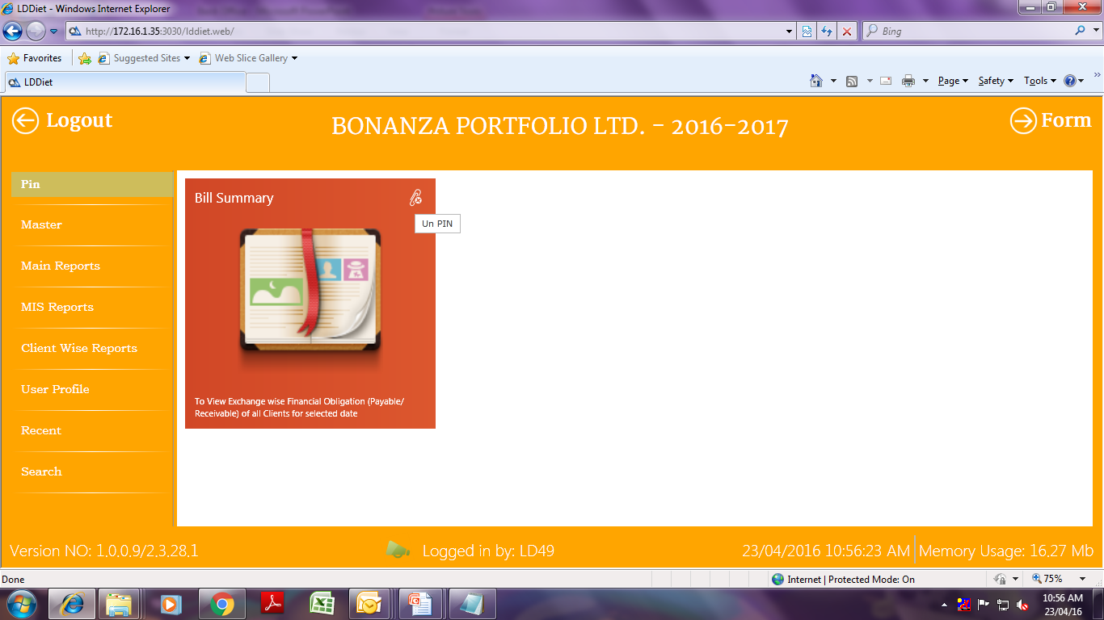
Pin You can customize Pin Option as per your Requirement.

Slide 9
Client Master To View Client Details like Contact Details, Brokerage etc.

Slide 10
Cont.. Client Master Screen On One Click – You can view all details of the client..

Slide 11
Main Reports

Slide 12
Report .. Client Bill

Slide 13
Report.. Beneficiary Holding Reports

Slide 14
Report.. Payment Request

Slide 15
MIS Reports : To View Client Wise T/O

Slide 16
Cont.. Turnover Report. You can export all client TO in excel.

Slide 17
Client Wise Report Client wise bill Summary, Transaction Summary, Financial Status, Holding Status.

Slide 18
How to Extract Reports..

Slide 19
Export to Excel To export ledger of all clients

Slide 20
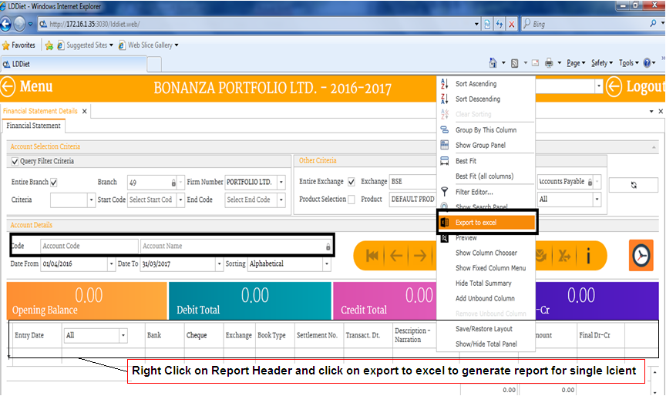
Export to Excel Right Click on “Header” and Export to Excel for any particular client ledger.

Slide 21
Others

Slide 22
Recent – navigations..

Slide 23
Search

